Slide 1
COMP208 FINAL REVIEW
EPTS COMP Tutor Shabbir Hussain
This version does not contain any worked solutions. I’ll release that version right after the review session. If you are really curious, you can try running the code.

Slide 2
Useful Links
Course Summary:
http://s3.amazonaws.com/docuum/attachments/2086/comp%20208%20info.pdf?1240285685
Run C code online:
http://codepad.org/
http://www.compileonline.com/compile_c_online.php
Run Fortran code online:
http://www.compileonline.com/compile_fortran_online.php

Slide 3
Study Strategies
Do past finals
Check the course website
Start by doing the hardest questions first
Test your code on the computer
Make a cheat sheet (as an exercise)

Slide 4
Contents
Pointers
Trick Questions
Big O
Sorting
Recursion
Numerical Methods

Slide 5
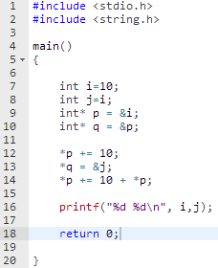
Pointers Example
What will be printed if we run this program?
Solve this problem as if you’re executing the code like a computer
Disclaimer: the techniques shown are not necessarily how the computer does it, but how you should do it on an exam
Copy paste the code from the notes below
Notes:
#include <stdio.h>
#include <string.h>
main()
{
int i = 10;
int j = i;
int* p = &i;
int* q = &p;
*p += 10;
*q = &j;
*p += 10 + *p;
printf("%d %d\n", i ,j);
return 0;
}

Slide 6
Pointers more Examples
#include <stdio.h> main() { int a[10]; int *p =a; int i; for(i=0; i<10; i++){ a[i]=10-i; } printf("%d %d %d %d\n",a[3],*p,p[4],*a+5); return 0; }
What is the output of this program?

Slide 7
Trick Questions (Don’t be fooled)
#include <stdio.h> #include <string.h> void abc(float, float, float); main() { float y =2.5; abc(6.5, y, y); printf("%f\n", y); return 0; } void abc(float x, float y, float z){ y = y-1; z = z+x; }
What is the Output of this program?
Hint: answer is on the next slide in version 2. You’ll have to come to the tutorial :)
Taken from Fall 2007 Final

Slide 8
Trick Questions (Don’t be fooled)
program exam IMPLICIT NONE INTEGER :: array(5), i, k Do i=1,5 array(i) = i END DO DO k=5,1,-1 array(k) = mod(array(i-1), array(k)) END DO WRITE (*,*) (array(i), i=1,5) end program exam
What is the Output of this Program?
Taken from Fall 2006 Final

Slide 9
Trick Questions (Don’t be fooled)
General Solution to these types of problems:
Know your stuff
Relax, its not worth that much anyway

Slide 10
Big O
How does the Upper bound complexity grow?
Its a measure of either run-time or resources (memory slots, etc.)

Slide 11
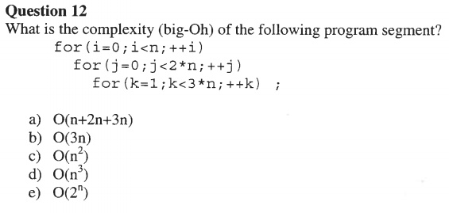
Big O
Taken from fall 2006 final

Slide 12



Sorting Algorithms in Plain English
One pass of Bubble sort:
Start at the back
Swap if that element is less than the preceding
Move to the next element (continue till first element)

Slide 13

Sorting Algorithms in Plain English
One pass of Selection sort:
Find the smallest element
Swap it with the front

Slide 14
Sorting Algorithms in Plain English
One pass of Selection sort:
Find the smallest element
Swap it with the front
What would the array look like after a second pass?

Slide 15

Sorting Algorithms in Plain English
1st pass:
One pass of Insertion sort:
Take an element from the rest of the list
Insert it to the sorted list
2nd pass:
3rd pass:

Slide 16
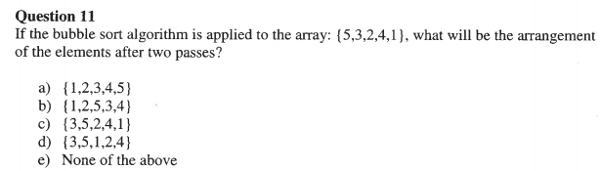
Sorting Pop Quiz
Taken from 2006 Fall Final

Slide 17
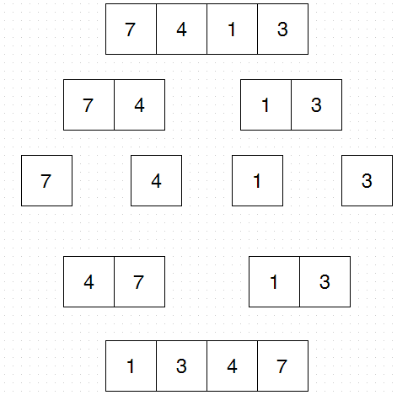
Sorting Algorithms in Plain English
Merge sort:
If list has only one element you are done
otherwise separate it into two lists
merge sort on first half
merge sort on second half
recombine

Slide 18
Recursion
#include <stdio.h> #include <string.h> int f(int x, int n){ if(n<4) return f(x+1,n+1) + f(x+2,n+1); else return x; } main() { printf("%i\n", f(0,0)); return 0; }
What is the output of the following Program?
Hint: expand the function

Slide 19
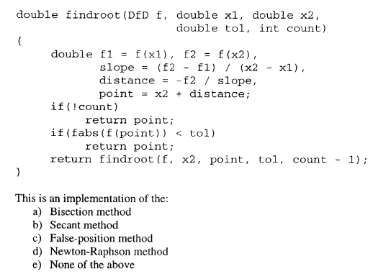
Numerical Methods
Taken from Fall 2005 final

Slide 20
Numerical Methods (root finding)
Passing functions as Arguments
typedef double (*DfD) (double); typedef double (*DfDD) (double, double); typedef double (*DfDDD) (double, double, double); double bisection_rf(DfD f, double x0, double x1, double tol);
f is of type DFD which is a function that takes a double as input and returns a double

Slide 21
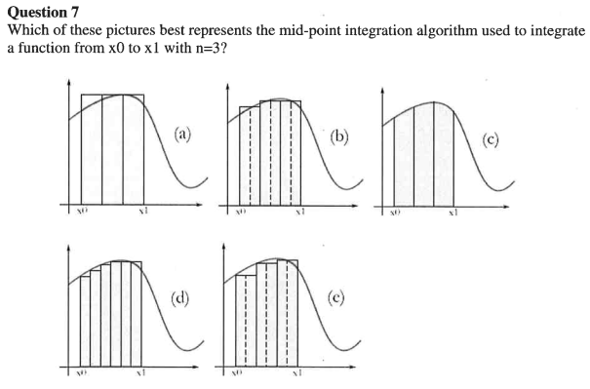
Numerical Methods (Integration)
Taken from winter 2007 final

Slide 22
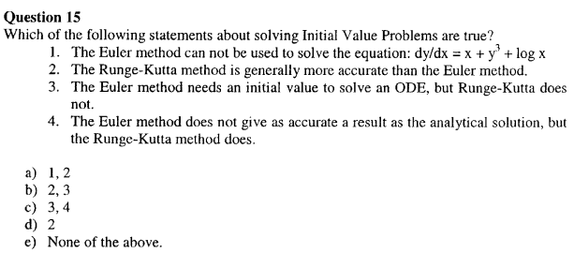
Numerical Methods (IVP)
Taken from Fall 2005 final

Slide 23
Numerical Methods
Is there a trick to do these types of problems?
Yes. Memorize all the algorithms

Slide 24
Good Luck!

